Slide 1




Slide 2


Process of converting plaintext into ciphertext, with the purpose of protecting sensitive information
Reverse process that aims to convert the ciphertext (encrypted text) back into plaintext, this step allows messages to be securely received and read

Slide 3


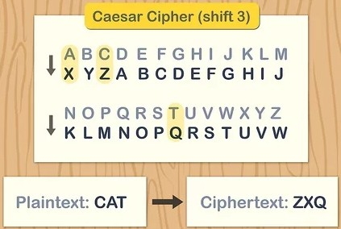
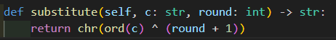

The substitute method performs a simple XOR substitution on a character using a provided round number.
Input Parameters: It takes a character c and an integer round.
XOR Operation: The method computes the XOR of the ASCII value of c (obtained using ord(c)) with (round + 1).
Return Value: The result of the XOR operation is converted back to a character using chr(), and this new character is returned.

Slide 4


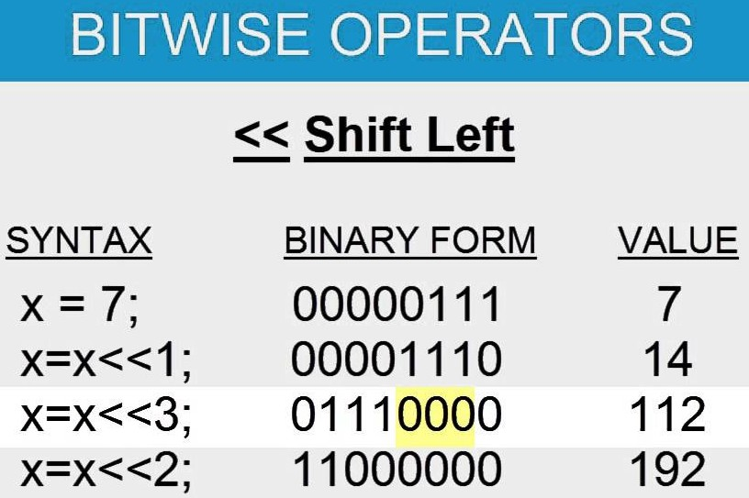


The bit_shift method performs a circular bit shift on each character of the input string based on the specified round number
Input Parameters: It takes a string input_text and an integer round.
Shift Calculation: The method calculates shift as round % 8, which ensures the shift is within the bounds of a byte (0 to 7).
Bitwise Operations:
For each character in input_text, it:
Shifts the character’s ASCII value left by shift bits using ord(c) << shift.
Uses & 0xFF to keep only the lower 8 bits (to prevent overflow).
Shifts the ASCII value right by (8 - shift) bits and combines it with the left-shifted value using the bitwise OR operator.
Return Value: The result for each character is converted back to a character with chr() and joined into a new string, which is returned.

Slide 5


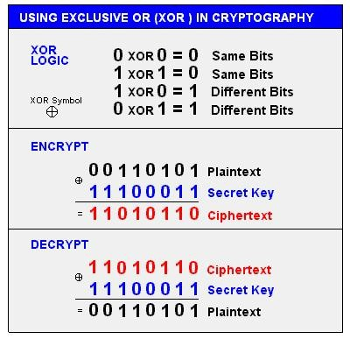

The XOR_with_key method performs an XOR operation between a given string text and a key
Input Parameters: It takes two strings, text and key.
Key Length: The length of the key is calculated and stored in key_len.
XOR Operation:
For each character in text, the method:
Uses the index i to determine the corresponding character in the key, cycling through it with i % key_len.
Performs an XOR operation between the ASCII values of the text character and the key character using ord().
Converts the result back to a character with chr().
Return Value: The results for each character are concatenated into a new string, which is then returned.

Slide 6





Step 1: Substitution (change characters) Step 2: Bit Shifting (shift bits)
Step 3: XOR with Key (combine with secret)
Step 4: Substitution again
Repeat for 10 rounds
Step 1: Reverse Substitution (reverse changes) Step 2: XOR with Key (use same key)
Step 3: Reverse Bit Shifting (shift back)
Step 4:Reverse Substitution again
Repeat for 10 rounds

Slide 7

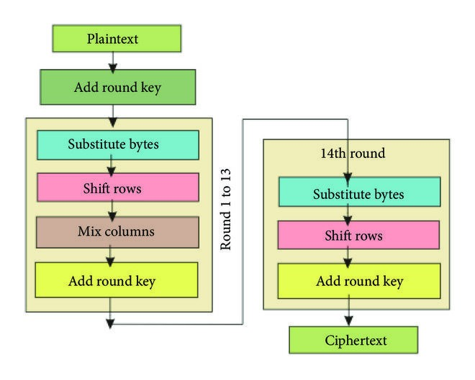
By using multiple rounds, the complexity of patterns is increased considerably, while also being harder to decipher without the key

Slide 8


